Slide 1

SDET Course
Design Patterns - Flyweight

Slide 2
3 Types of Design Patterns
Creational
Singleton
Builder
Prototype
Factory Method
Abstract Factory
Structural
Adapter
Composite
Proxy
Flyweight
Bridge
Facade
Decorator
Behavioral
Strategy
Observer
Command
Memento
State
Template Method
Mediator
Chain of Responsibility
Interpreter
Visitor
Iterator

Slide 3
Agenda
Description
Diagram
Code sample (Java)
Use cases

Slide 4

Description
Introduction - A Library

Slide 5
Description
The Flyweight design pattern is a structural pattern used to minimize the memory usage and improve performance in contexts that use a large number of similar objects. By sharing common parts of the object state among multiple objects instead of keeping all the data in each object, it significantly reduces the overall memory footprint of the application. This is especially useful in applications involving extensive graphics, such as a word processor or a game, where objects like characters, textures, or trees can be reused without the need to create new ones. The pattern distinguishes between intrinsic state, which is shared and can be stored in the flyweight, and extrinsic state, which varies between objects and cannot be shared. The flyweight acts as a factory that creates and manages the flyweight objects; it ensures that objects that are identical from a resource perspective are shared rather than duplicated.

Slide 6
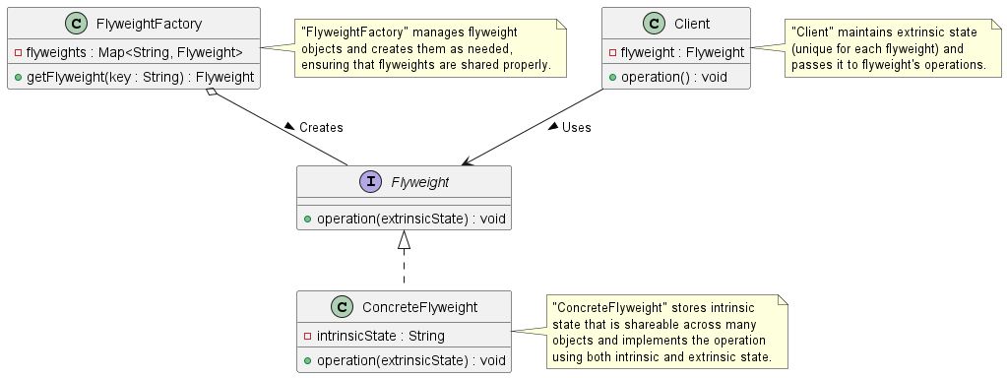
Class Diagram

Slide 7
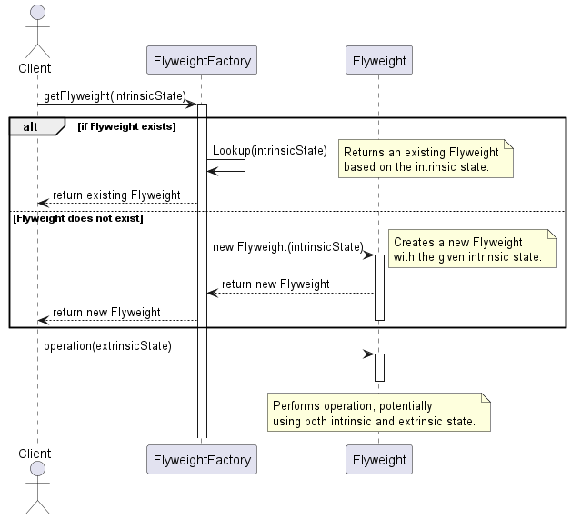
Sequence Diagram

Slide 8
Code Sample

Slide 9
Use cases
General
Text editors (characters as flyweights)
Repetitive GUI elements
In Test Automation
Browser instance management (one browser, multiple tabs?)
Elements instance management

Slide 10
Happy Coding

